Slide 1
SKIN CANCER CLASSIFICATION
MACHINE LEARNING WITH TENSORFLOW
Authors: ANTHONY AKO SOWAH, Stephan Pries, Natnael Guesh Hagos & Hammam Rafat Mohamed Hraesha

Slide 2
Agenda
Introduction
Literature Review
Dataset Characteristics
Baseline Model
Model Definition and Evaluation
Results
Challenges and Errors
Discussion, Conclusion & Future Work
Q & A

Slide 3
Introduction
Skin cancer is one of the most common and dangerous types of cancer.
This project uses deep learning to automatically classify skin lesion images into different cancer types using the HAM10000 dataset.
We apply a MobileNetV2, EfficientNetBx models to help improve early detection and support medical diagnosis.

Slide 4
Literature Review
Studies show that deep learning models like MobileNetV2 and EfficientNetBx, especially with transfer learning, perform well on HAM10000.
Adding patient info (age, gender, lesion site) improves accuracy in tough cases.
Ensemble methods and attention tools (like Grad-CAM) boost both performance and interpretability.
Overall, combining image data with clinical context delivers the best results.

Slide 5
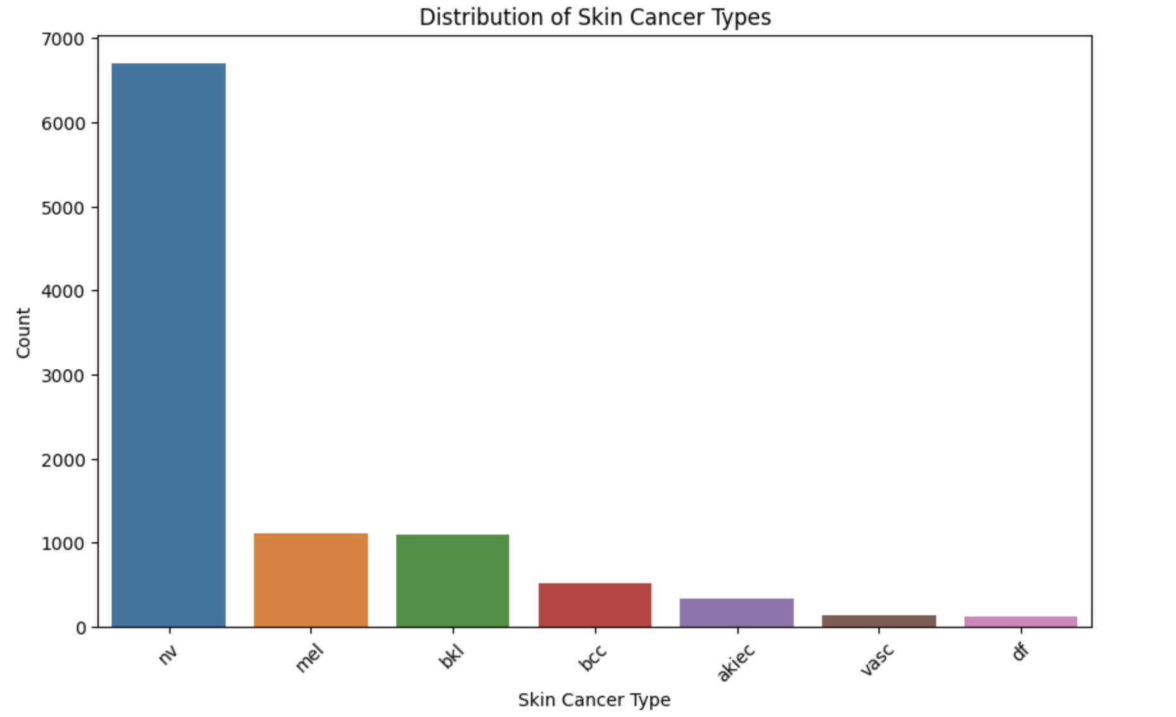
Dataset characteristics
Benign Classes | Malignant / Precancerous Classes
Melanocytic nevi (nv) | Melanoma (mel)
Benign keratosis-like lesions (bkl) | Basal cell carcinoma (bcc)
Dermatofibroma (df) | Actinic keratoses and intraepithelial carcinoma (akiec)
Vascular lesions (vasc)

Slide 6
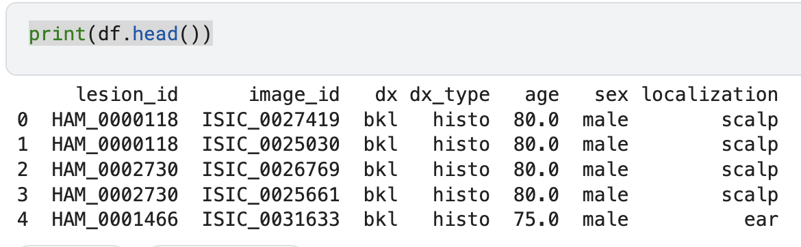
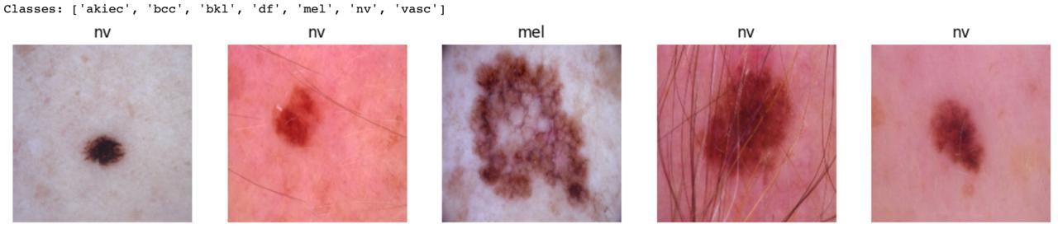
Dataset characteristics
IMG_SIZE 224x224

Slide 7
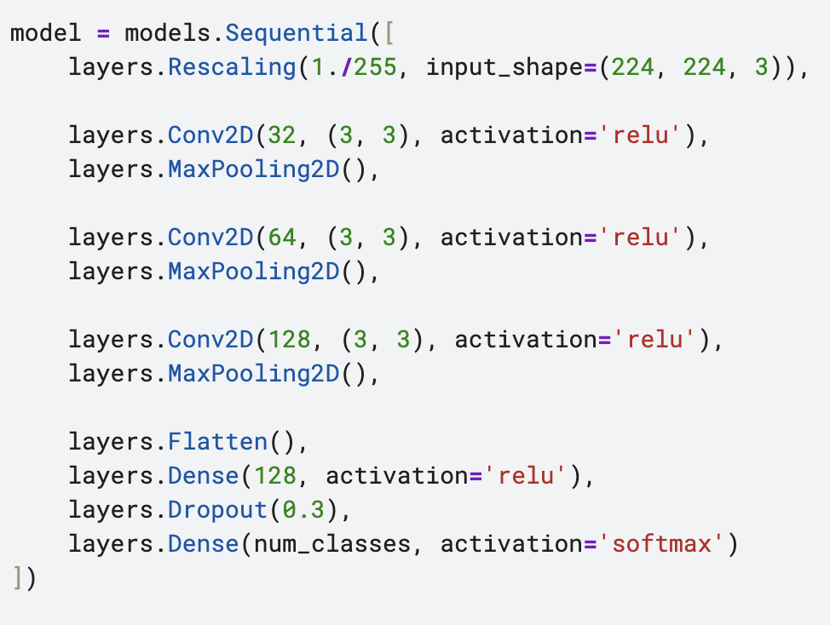
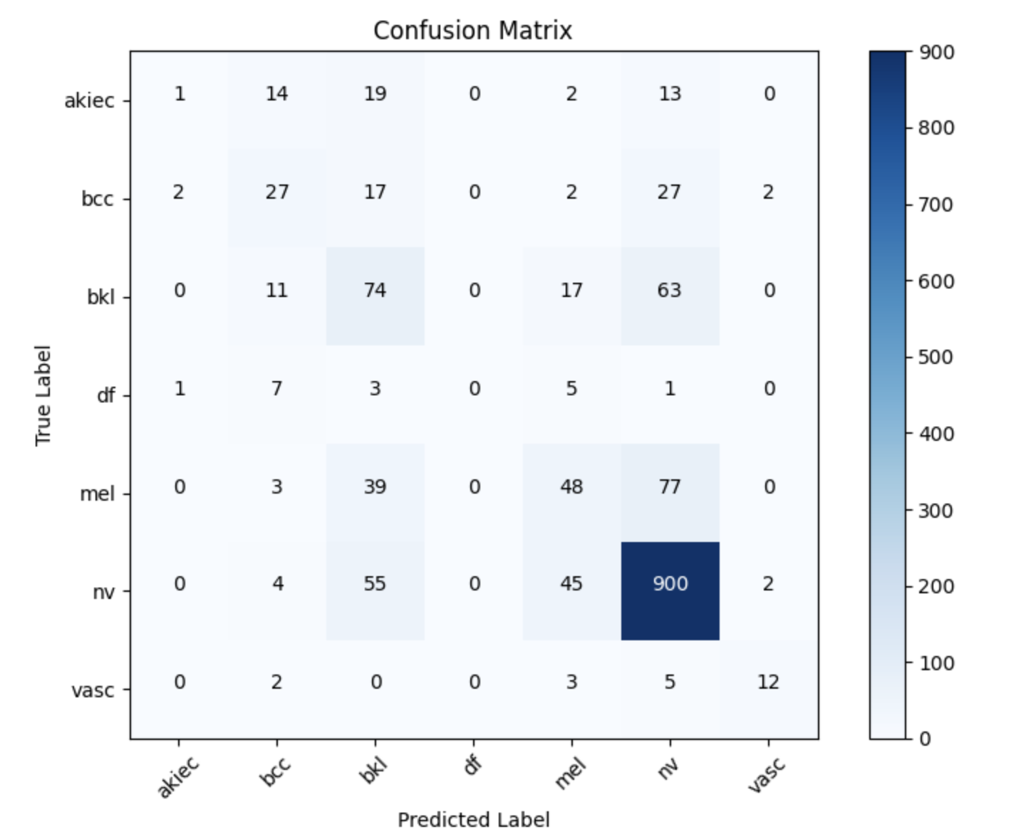
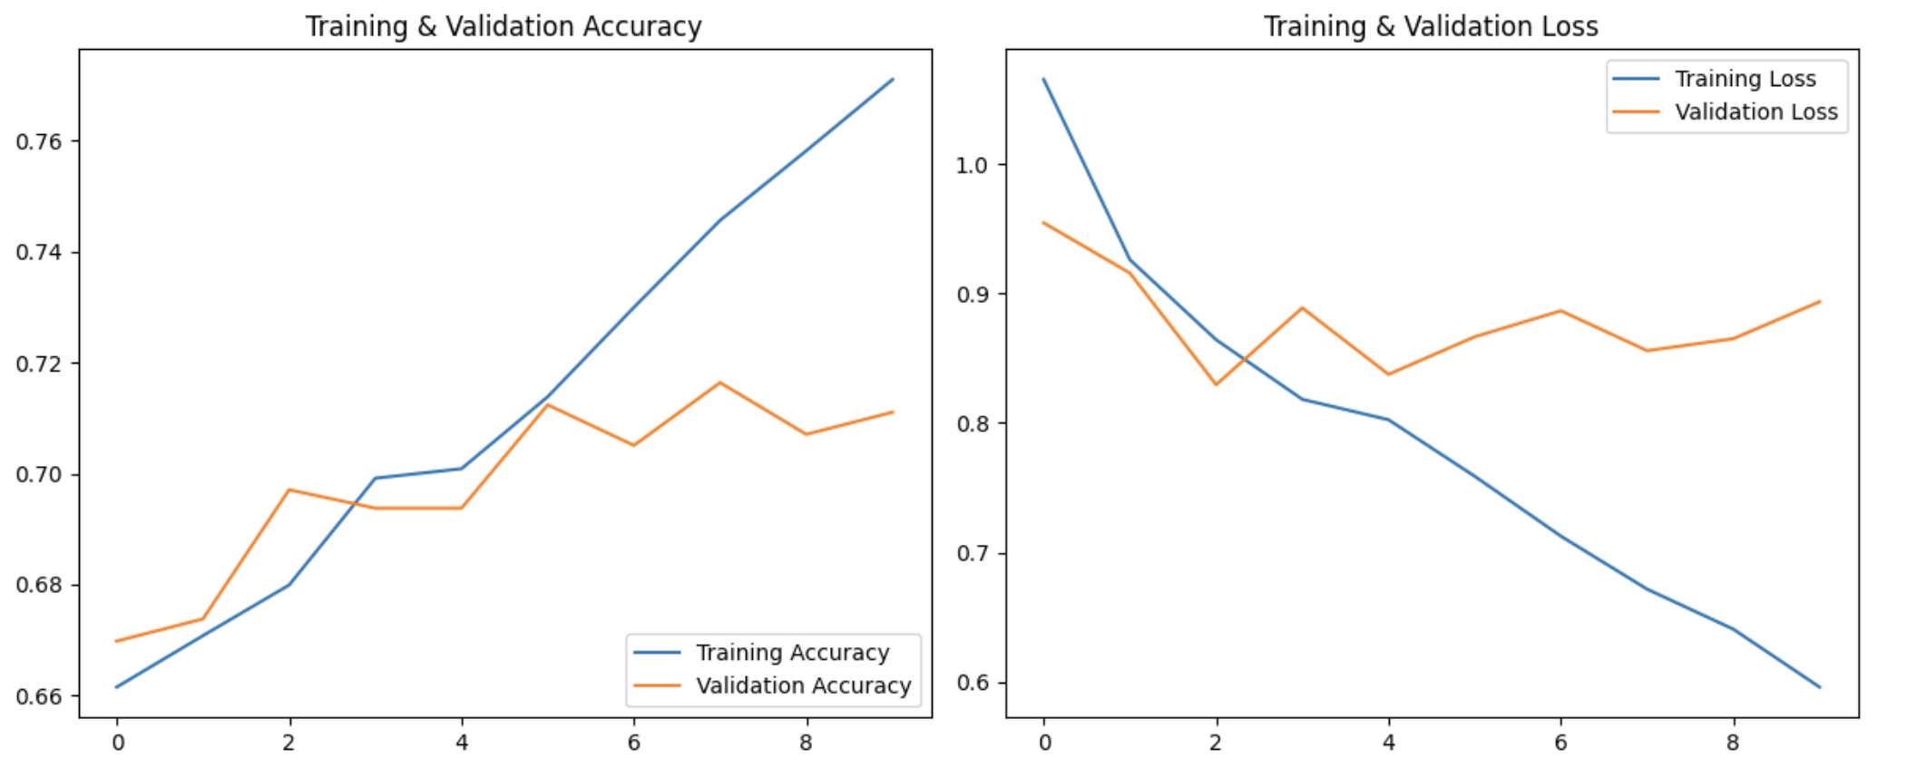
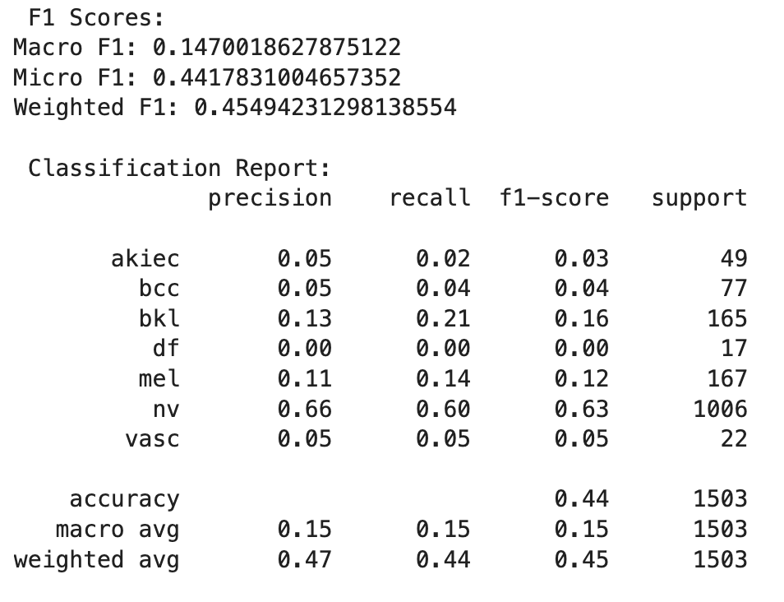
BASELINE MODEL
test accuracy: 0.7066
poor f1- score per class
nv - relatively high accuracy
nv true positives at 900
nv misclassifications: 55 as bkl, 45 as mel, etc.
mel heavily confused with 77 nv
mel true positive 48

Slide 8
MODEL DEFINITION AND EVALAUATION
Transfer learning
MobileNetV2
EfficientNetBx
Ensemble (MobileNetV2/EfficientNetB1)
Training steps
Data augmentation
Unfreezing of layers
Focal-Loss with class weight
DropOut
Learning rate variation
Accuracy Benchmark: 73 – 79 % Kaggle Challenges with specific dataset
88 – 92 % Literature Optimum for Ensemble Models with other datasets

Slide 9
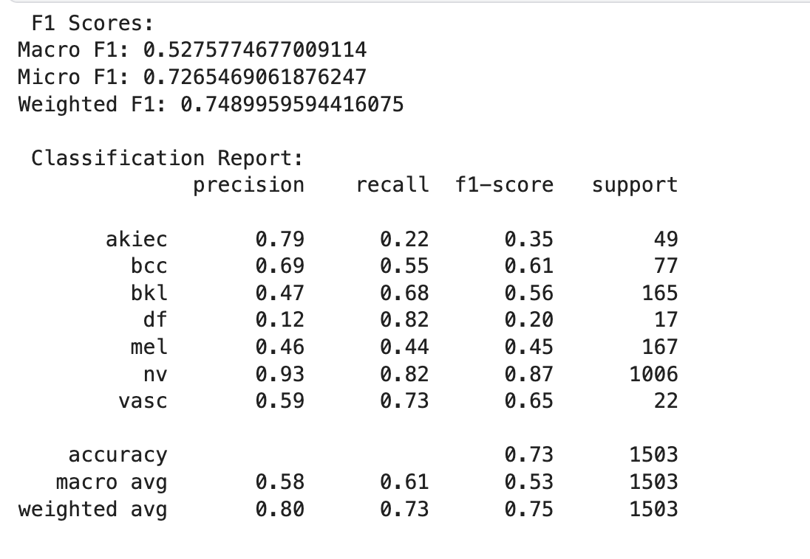
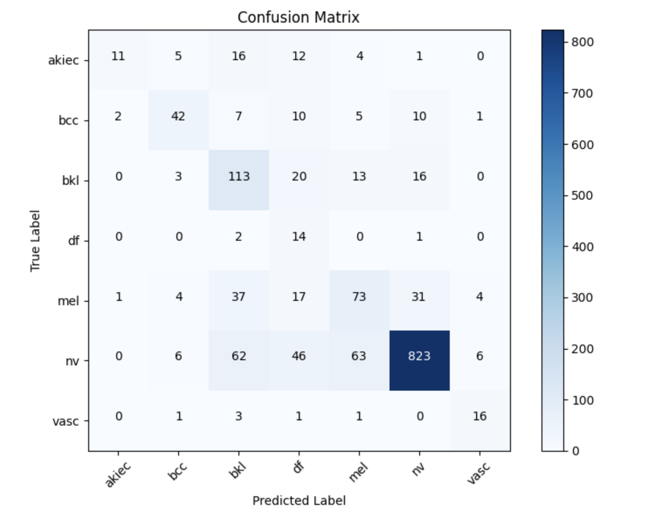
Transfer learning MobileNetV2
Epochs 60
dynamic LR 1.e-4
reduced gamma 1.5
Unfreeze deeper layers
Reduce LR
Early Stopping
Test Accuracy:7265

Slide 10
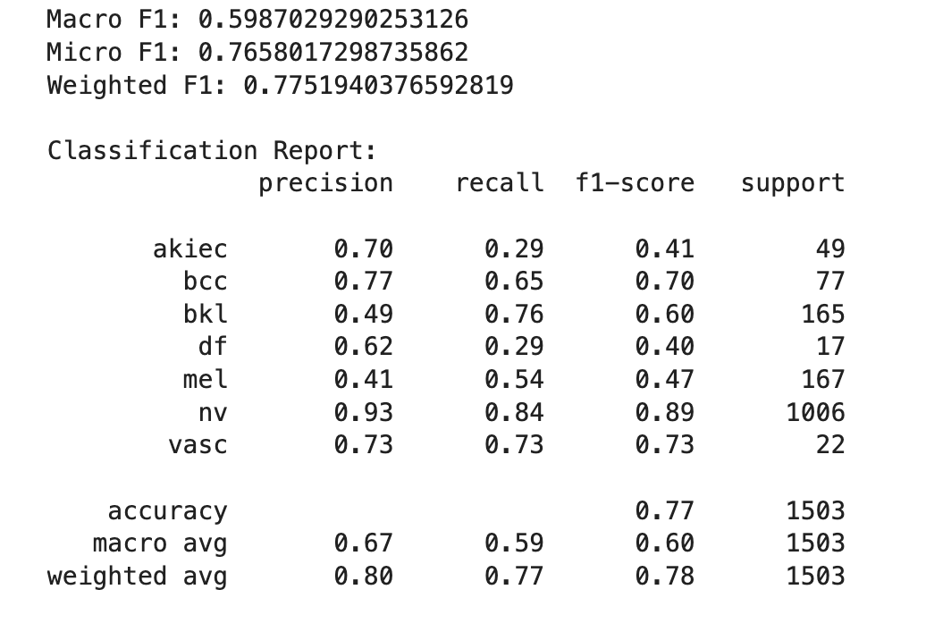
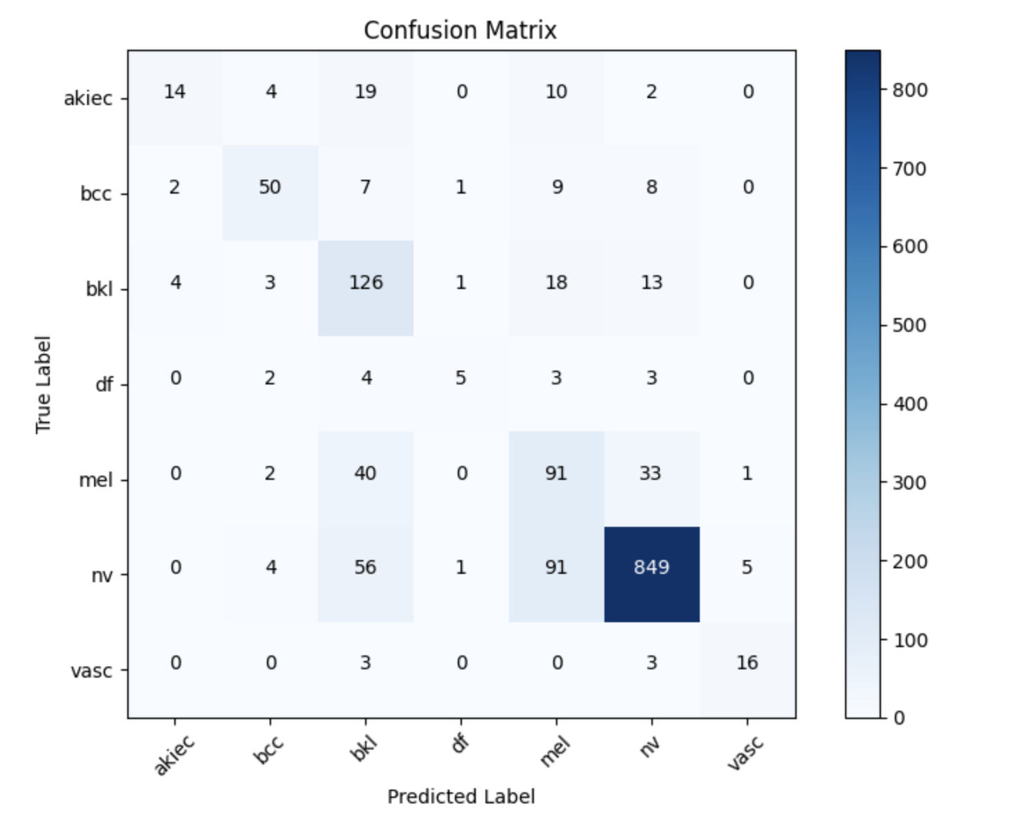
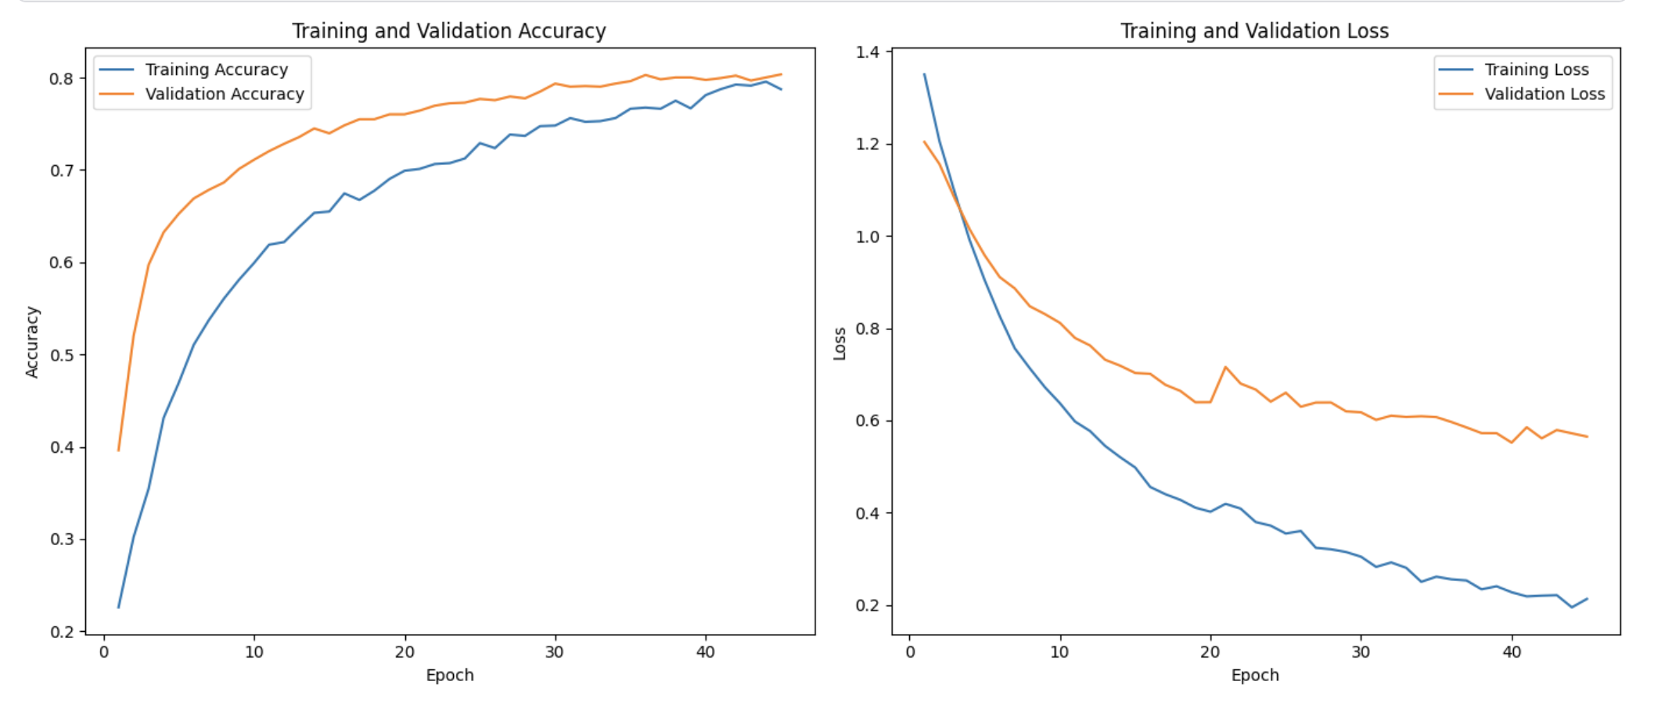
Transfer learning efficientnetb1
Epochs 70
LR 0.0001
Unfreeze 100
Gamma 1.5
Callback 55
Continue Training
Adjusting Parameters
Test Accuracy: 0.7658

Slide 11
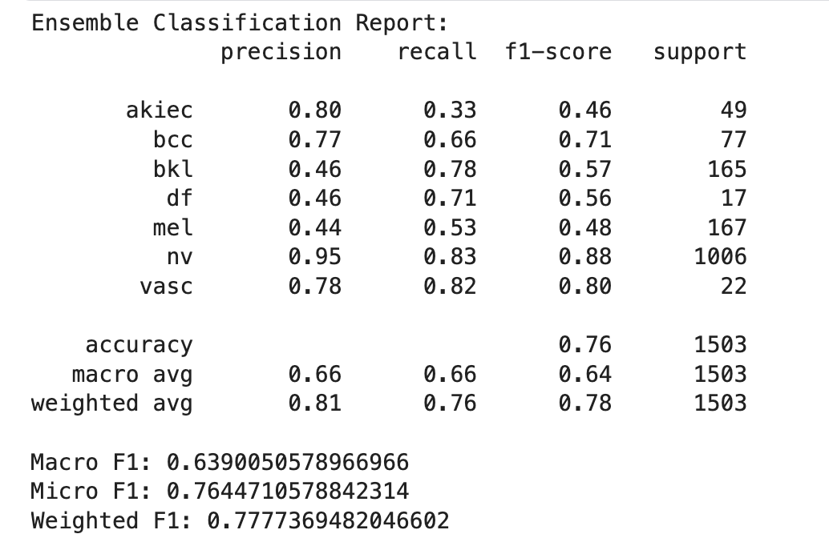
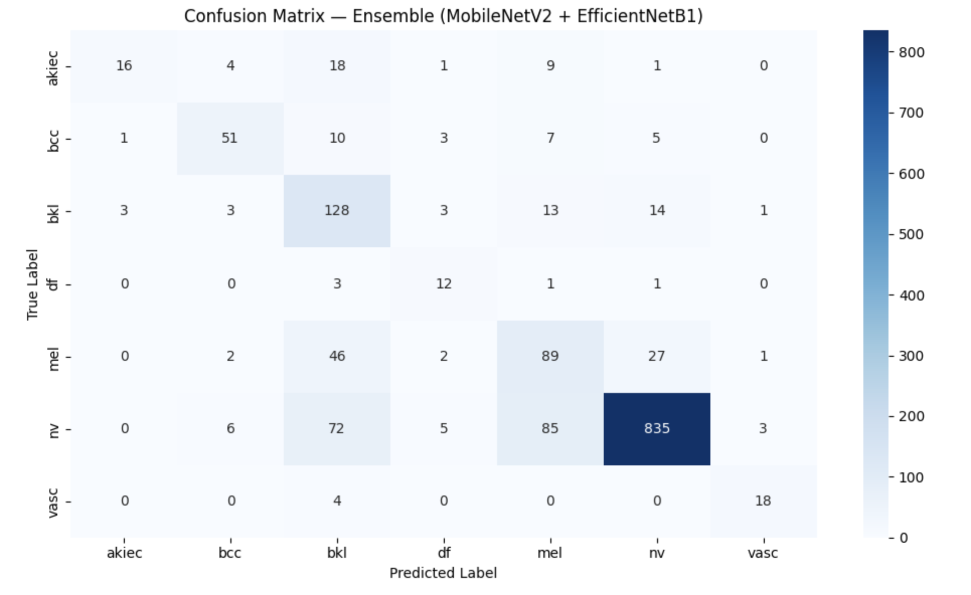
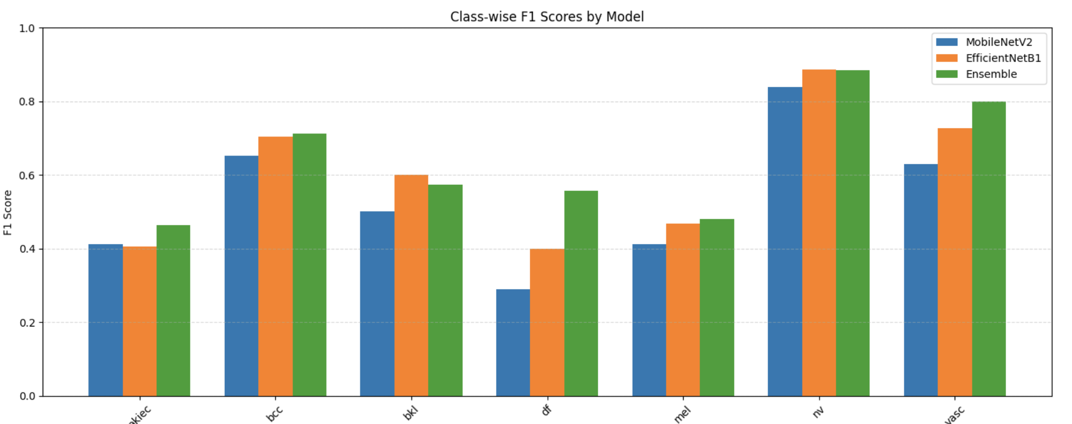
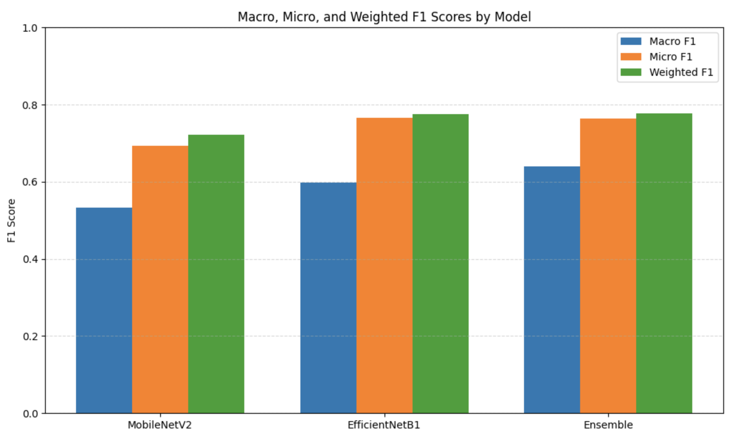
Transfer learning Ensemble mobilenetv2 and efficientnetb1

Slide 12
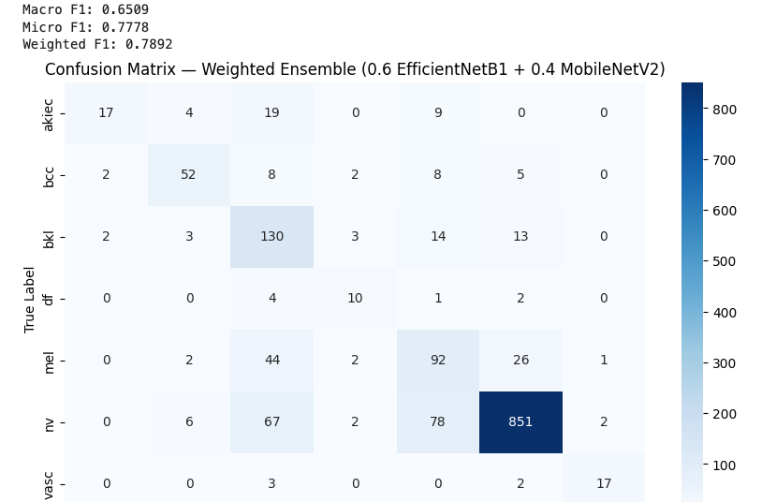
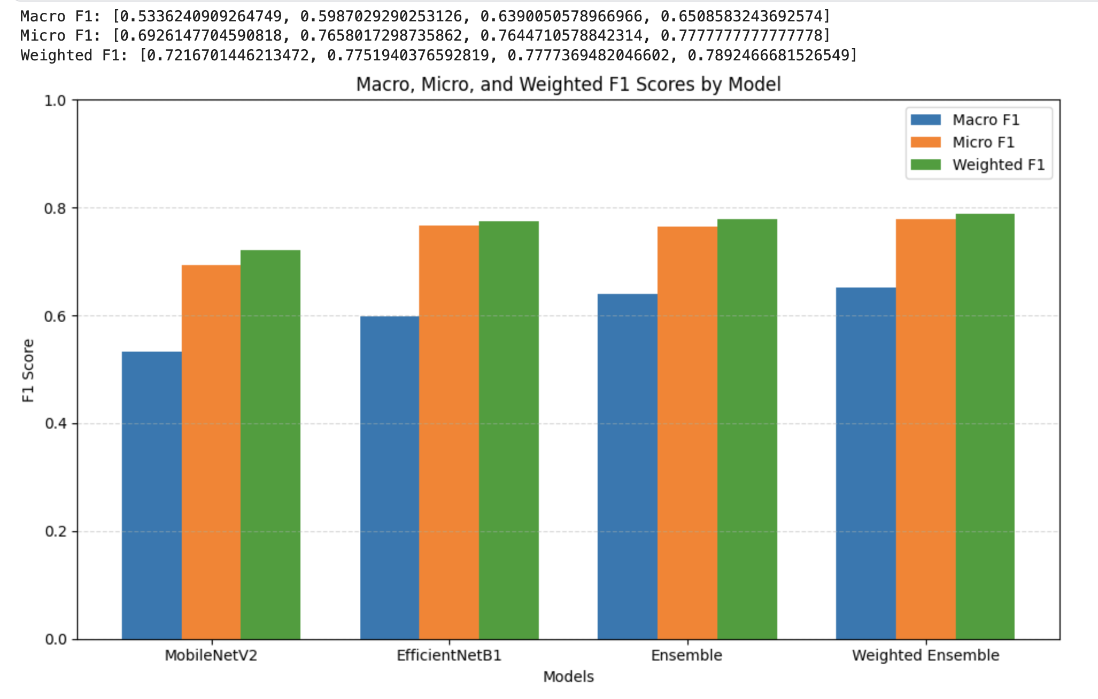
Ensemble with weight (0.6 and 0.4)

Slide 13
challenges
Running out of RAM
Dataset imbalance
Image resolution
Short time frame

Slide 14
Discussion, Conclusion and future works
our approach during training was not to misclassify malignant lesions but to optimize f1 and precision
accuracy from base model of 0.71 increased up to 0.79 which comes close to Kaggle Challenges but is far away from literature
Future work
Optimize f1 and precision etc.
Add metadata for training
Run model with different datasets (probably with higher resolution)
Employ Grid search to ideentify best optimized values for the two ensemble models

Slide 15


